Slide 1

Image Segmentation & U-Net
COMPUTER VISION METHODOLOGIES
Presented by
Dr. Ahmed Yousry

Slide 2

PART 01
Fundamentals of Image Segmentation
An introduction to standard pixel-level classification paradigms, comparing semantic versus instance approaches and historical mathematical solutions.

Slide 3

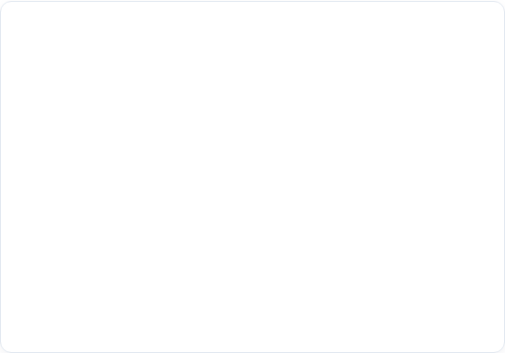
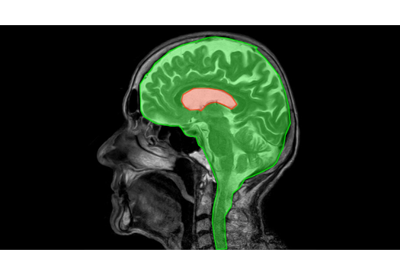
What Is Image Segmentation?
The Core Concept
■
Pixel-Level Mapping: Image segmentation is the crucial process of partitioning a digital image into multiple distinct regions comprising groups of pixels or "super-pixels".
■
Feature Categorization: It effectively assigns meaningful semantic labels to each pixel, helping machines identify contextual boundaries.
■
Target Isolation: Rather than predicting global features (like standard classification), segmentation focuses on exactly "where" specific targets exist down to structural contours.

Slide 4


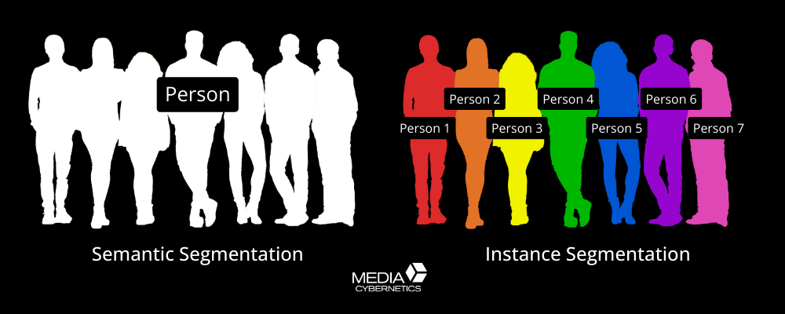
Semantic vs. Instance Segmentation
Semantic Segmentation
Instance Segmentation
Definition: Classifies all pixels within the image into predefined, semantically interpretable categories of real-world objects.
Definition: Identifies, outlines, and catalogs every discrete occurrence of every target category mapped within an image.
Key Aspect: It explicitly separates individual boundaries of identical classes. Instead of a unified group class, it creates distinct bounding structures (e.g., separating "Car 1", "Car 2", and "Car 3").
Key Aspect: It does not distinguish between individual objects of the same class. If three cars are parked side-by-side, all pixels representing them are designated identically as "car".

Slide 5






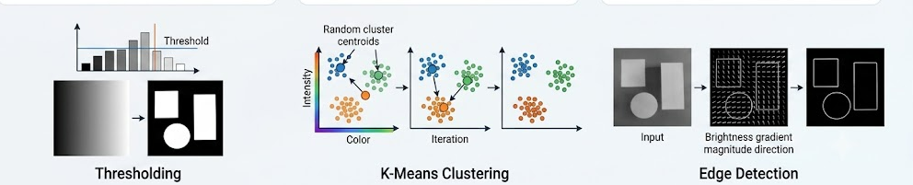
Traditional Segmentation Techniques
Thresholding
K-Means Clustering
Edge Detection
Separates pixels based on static intensity values to isolate objects from backgrounds, transforming grayscale frames into sharp binary maps.
An unsupervised iterative clustering algorithm partitioning data organically into distinct groups based on numeric feature and color similarities.
Tracks sudden localized variations or mathematical discontinuities in brightness to isolate regional contours and object outlines.

Slide 6
PART 02
The U-Net Deep Architecture
A detailed architectural walkthrough of U-Net, exploring the contracting and expanding paths alongside skip connection functionalities.

Slide 7
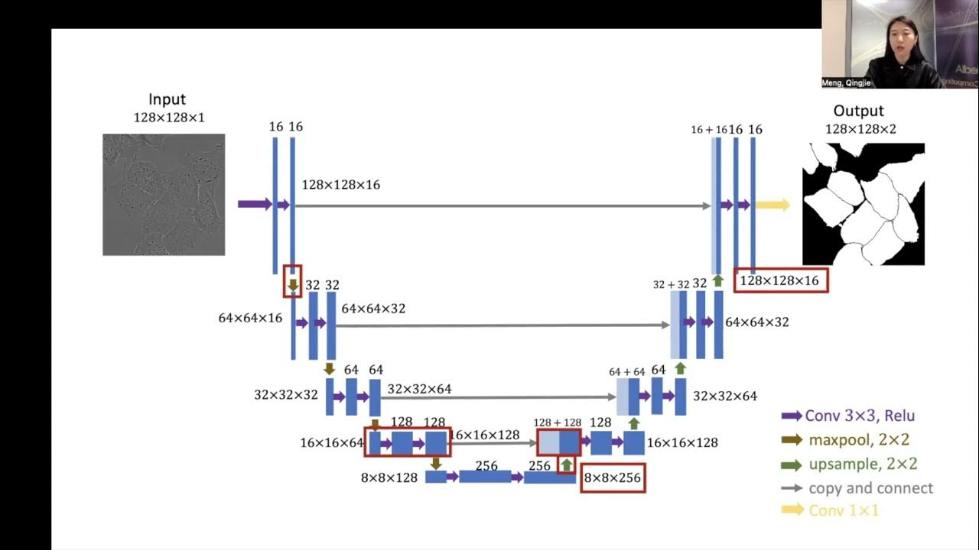
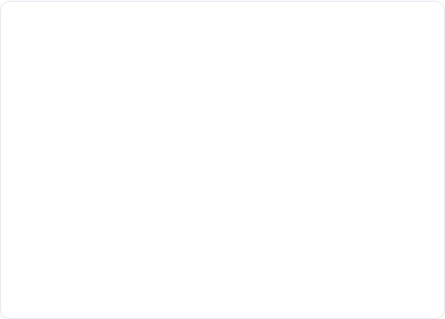
U-Net Architecture Overview
Symmetric Contracting & Expanding Design
■
Contracting Path (Encoder): Sequential 3x3 convolutions and 2x2 max-pooling reduce spatial matrices to abstract rich feature context.
■
Expanding Path (Decoder): Successive up-sampling layers precisely reconstruct spatial dimensions to provide localization accuracy.
■
Skip Connections: High-resolution spatial feature maps are direct-copied and concatenated to preserve sharp structural contours.

Slide 9


Decoder Upsampling Mechanics
UpSampling2D
Conv2DTranspose
Mechanism: A static, non-learnable layer that doubles spatial dimensions by duplicating rows and columns of the incoming feature matrix.
Mechanism: Also referred to as deconvolution. A learnable up-scaling operation where kernels apply parameterized weights to reconstruct missing pixel data.
Advantage: Uses standard geometric interpolation (nearest-neighbor or bilinear). It is computationally efficient and introduces no parameters, ensuring incredibly fast runtime execution.
Advantage: The network actively learns the optimal spatial reconstruction filters during the training process, leading to more intricate and precise edge boundary outputs.

Slide 10
PART 03
Metrics & Mathematical Evaluation
Detailed coverage of Intersection over Union (IoU), Jaccard parameters, Dice similarities, and mathematical modeling techniques.

Slide 11
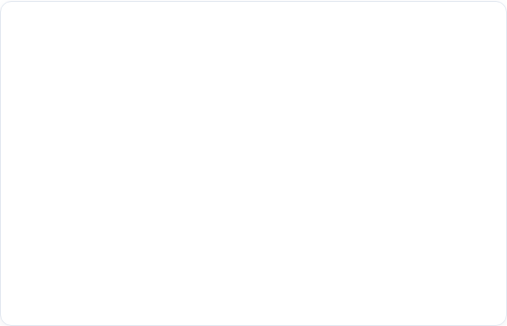
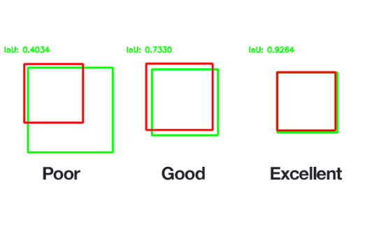

Intersection Over Union (IoU)
The standard evaluation metric used in structural segmentation, evaluating predicted masks against ground-truth labels.
■
Overlap Quotient: Quantifies the region of shared target overlap divided by the total visual union.
■
Standard: Scores range from 0.0 (no overlap) to 1.0 (flawless matching).

Slide 12
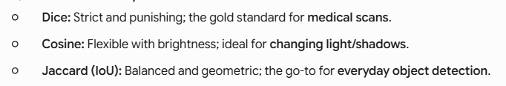
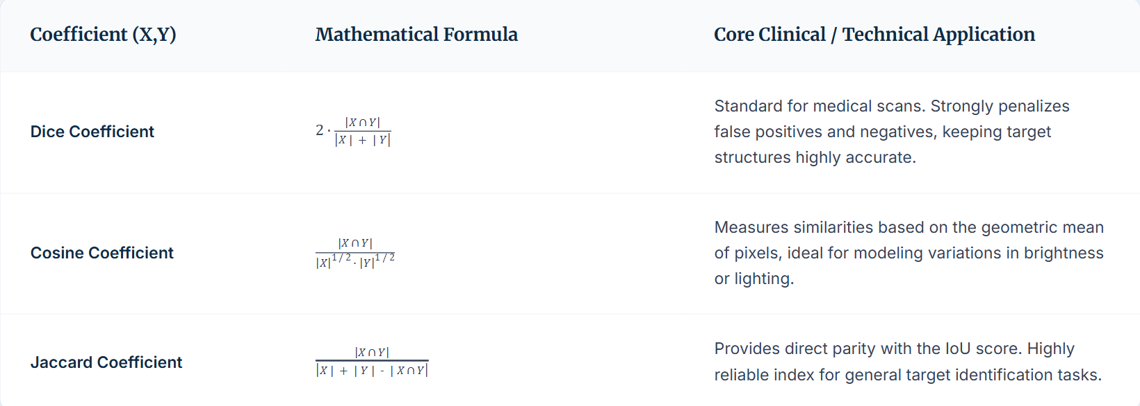
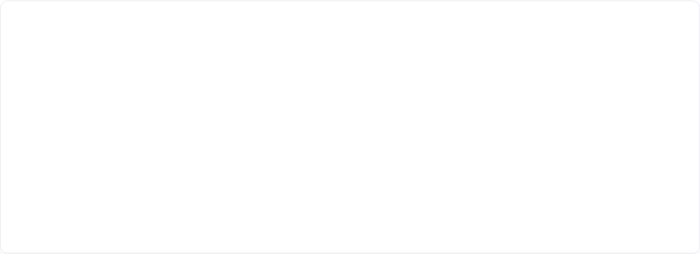
Similarity Metric Formulations

Slide 13
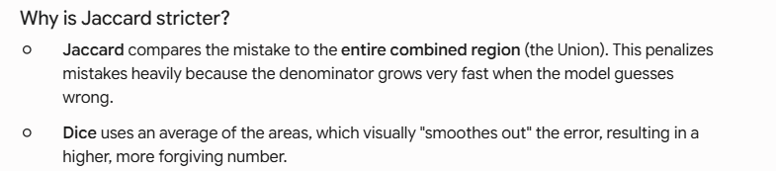
Metric | Stricter? | Standard Acceptable Target | Excellent/Production Target
Dice Coefficient | No | >= 0.80 | >= 0.85
Cosine Similarity (Ochiai) | No | >= 0.80 | >= 0.85
Jaccard Index (IoU) | Yes | >= 0.70 | >= 0.75

Slide 14
Questions & Discussion
Image Segmentation & U-Net Architecture
Thank you for your attention.
Presented by Dr. Ahmed Yousry

Slide 15



Image Sources
https://keymakr.com/blog/content/images/2024/01/km12.jpg
Source: keymakr.com
https://lmb.informatik.uni-freiburg.de/people/ronneber/u-net/u-net-architecture.png
Source: lmb.informatik.uni-freiburg.de
https://b2633864.smushcdn.com/2633864/wp-content/uploads/2016/09/iou_examples.png?lossy=2&strip=1&webp=1
Source: pyimagesearch.com

